Slide 1
Windows Administration
Telerik Software Academy
academy.telerik.com
Active Directory Domain Services
Borislav Varadinov
System Administrator
bobi@itp.bg

Slide 2

Table of Contents
Domains and Forests
Objects
Sites and Replication
Operation Masters

Slide 3
Active Directory
Domains and Forests

Slide 4

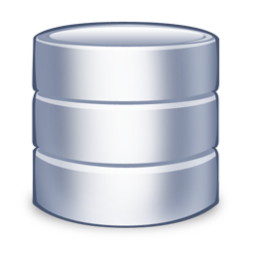

What is a Domain Controller?
User | Pass
John | P@sswOrd
Jane | 12345
OBJECT
AD DB
Manages the Active Directory Objects and Database
Responds to security authentication requests
Replicates information from other domain controllers
Provides information for various network resources
Can be Writable or Read Only

Slide 5
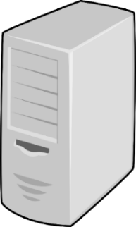

What is a Domain?
MyCorporation.local
AD
DB
Replication
AD
DB
AD DB
Boundary of Replication
Boundary of Administration
Boundary of DNS Namespace

Slide 6


What is a Forest?
BeraXoConsultancy.org
BeraXo.local
All Domains in a Forest share:
Schema
Configuration
Global Catalog
The forest is also considered as a security boundary
USA.BeraXo.local

Slide 7


Schema
Attributes
Username
Description
Location
Classes
User
Computer
Contact
User
Username
Name
Password
Address
Email
Contact

Slide 8
Naming Contexts and Partitions
Schema
Definitions of object classes and attributes
Replicated to all DCs in the forest
Configuration
AD Structure (domains, sites, etc.)
Replicated to all DCs in the forest
Domain
Domain specific objects (users, groups, computers, and OUs)
Replicated to all DCs in a domain
Application Partitions

Slide 9
Global Catalog
Partial Replica of all Objects in the Forest
Configurable subset of Attributes
Fast Forest-wide searches
Required at Logon for Universal Group Membership
Win2k3 – Universal Group Caching

Slide 10
Trusts
External or Forest
Type
Parent/Child
External
Forest
Shortcut
Realm
PartnerCorp.local
BeraXo.local
Child
Provides access to resources located on a domain in a separate forest
Trust options
Direction
Transitivity
USA.BeraXo.local

Slide 11
Active Directory and DNS
The DNS Service is an essential part of Active Directory
Active Directory cannot work without DNS Service (Even on a single server)
Active Directory and DNS share identical domain name
Domain Controller locator process rely on DNS
DNS Service can store its data in Active Directory

Slide 12
Active Directory Integrated DNS Zone
SRV Records to locate services
LDAP
Kerberos
Other
Active Directory-integrated DNS
DDNS for Dynamic Update
Single replication topology
Multi-master replication
Secure Dynamic update

Slide 13
Protocols and Technologies
LDAP
Kerberos
NTLM
RPC
DNS
DNS
NTLM
Kerberos
Replication
LDAP
RPC
DSA
Extensible Storage Engine
Windows OS

Slide 14
Active Directory
Objects

Slide 15
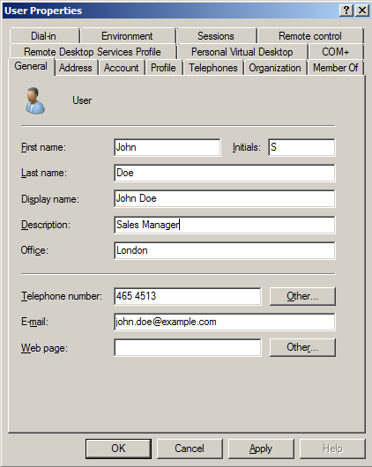
Domain Users
John

Slide 16


Domain Groups
Type
Security
Distribution
Scope
Domain Local
Global
Universal
HR Department
John
Bill
Kelly

Slide 17
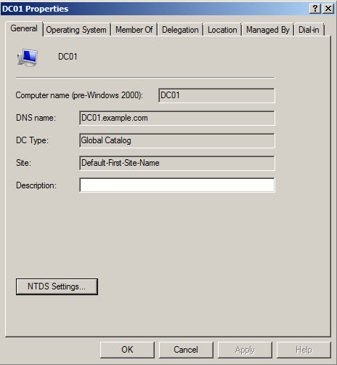
Domain Computers

Slide 18

Organizational Units
Containers within Domains
Organizes users, groups and other objects
Represents departments or geographic regions
Main uses:
Organization
Delegation
Policies
Users
IT
Sales

Slide 19
Domain Security Principles
Users
Groups
Computers
Built-in Security Groups
Administrators
Backup Operators
Users
Power Users
Print Operators

Slide 20
Active Directory
Sites and Replication

Slide 21
Active Directory Sites
What is a Site?
A set of well-connected IP subnets
Site Usage
Locating Services
Replication
Group Policy Application
Sites are connected with Site Links
Connects two or more sites

Slide 22



Site Usage (Location Services)

Slide 23
Site Usage (Replication)

Slide 24
Multi-Master Replication
Conflict resolution
Operation Masters

Slide 25
Operation Master

Slide 26
Operation Master
What is an Operation Master?
Why we need Operation Masters?

Slide 27
Operation Masters
Forest-Wide
Schema Master
Domain Naming Master
Domain-Wide
Primary Domain Controller (PDC)
Relative Identifier (RID)
Infrastructure Master

Slide 28
Schema Master
Performs updates to schema
Sends updates to all DCs
One per forest
Default is the first DC installed

Slide 29
Domain Naming Master
Performs add/remove of domains and cross-references to external DS
One per forest
Default is the first DC installed

Slide 30
Install Active Directory
Dcpromo
DNS
Management Tools

Slide 31
Active Directory Domain Services
http://academy.telerik.com

Slide 32




Free Trainings @ Telerik Academy
"Web Design with HTML 5, CSS 3 and JavaScript" course @ Telerik Academy
html5course.telerik.com
Telerik Software Academy
academy.telerik.com
Telerik Academy @ Facebook
facebook.com/TelerikAcademy
Telerik Software Academy Forums
forums.academy.telerik.com

